Slide 1
Presentation on Car Price Prediction Project Presentation
Submitted by:
Priyanka Saikia
Data Science Intern
Flip Robo Technologies

Slide 2
ACKNOWLEDGMENT
I would like to express my deep sense of gratitude to my SME (Subject Matter Expert) Mr. Shubham Yadav as well as Flip Robo Technologies who gave me the golden opportunity to do this data analysis project on CAR PRICE PREDICTION, which also helped me in doing lots of research and I came to know about so many new things.
I have put in my all efforts while doing this project.

Slide 3
PROBLEM STATEMENT
With the covid 19 impact in the market, we have seen lot of changes in the car market. Now some cars are in demand hence making them costly and some are not in demand hence cheaper. One of our clients works with small traders, who sell used cars. With the change in market due to covid 19 impact, our client is facing problems with their previous car price valuation machine learning models. So, they are looking for new machine learning models from new data. We have to make car price valuation model.

Slide 4
DATA COLLECTION PHASE
You have to scrape at least 5000 used cars data. You can scrape more data as well, it’s up to you. more the data better the model
In this section You need to scrape the data of used cars from websites (OLX, Car Dekho, Cars 24 etc.) You need web scraping for this. You have to fetch data for different locations. The number of
columns for data doesn’t have limit, it’s up to you and your creativity. Generally, these columns are Brand, model, variant, manufacturing year, driven kilometers, fuel, number of owners, location and at last target variable Price of the car. This data is to give you a hint about important variables in used car model. You can make changes to it, you can add or you can remove some columns, it completely depends on the website from which you are fetching the data.
Try to include all types of cars in your data for example- SUV, Sedans, Coupe, minivan, Hatchback.

Slide 5
MODEL BUILDING PHASE
After collecting the data, we need to build a machine learning model. Before model building do all data pre-processing steps. Try different models with different hyper parameters and select the best model. Follow the complete life cycle of data science. Include all the steps below.
1. Data Cleaning
2. Exploratory Data Analysis
3. Data Pre-processing
4. Model Building
5. Model Evaluation
6. Selecting the best model

Slide 6
DATA SCIENCE LIFE CYCLE
Data Cleaning
Import the collected data from web scraping
Exploratory Data Analysis
Check through all the dataset information like datatype, missing value, duplicate value etc.
Visualization and Data Preprocessing
Use various visualization methods to check the data distribution identify presence of outliers and skewness
Clean and format the records as per usage by using various imputation techniques
Analyze each and every data record to ensure we have usable information
Perform encoding and scaling methods
Model Building
Create appropriate Regression Machine Learning model function
Model Evaluation
Usage of evaluation metrics to check the accuracy of the models over trained and test data inputs
Hyperparameter Tuning Best Model
Choosing the appropriate Regression Machine Learning model to check various parameter permutation and combinations
Need to ensure that whenever the regression function is called it is able to process all the necessary parameters
Ensure the cross validation techniques helps in reducing over fitting and under fitting data
Using Grid Search CV to obtain the best parameters that can be plugged into the selected model

Slide 7
DATA PREPROCESSING
Importing the necessary dependencies and libraries.
Reading the CSV file and converted into data frame.
Checking the data dimensions for the original dataset.
Looking for null values and accordingly fill the missing data.
Checking the summary of the dataset.
Checking unique values.
Checking all the categorical columns in the dataset.

Slide 8
DATA PRE-PROCESSING
Visualizing each features using matplotlib and seaborn.
Performing encoding using the ordinal encoder on categorical features.
Checking for co-relation/multi-collinearity in a heatmap.
Checking for Outliers/Skewness using boxen plot and distribution plot.
Perform Scaling using Standard Scaler method.
Checking for the final dimension of dataset to confirm the input details.
Creating train test split and the best random state found in the range 1-1000.

Slide 9
Software Requirements and Tools Used
Software Tools used:
Programming language: Python 3.0
Distribution: Anaconda Navigator
Browser-based language shell: Jupyter Notebook
Libraries/Packages Used:
Pandas
Numpy
Matplotlib
Seaborn
Sklearn

Slide 10
EXPLORATORY DATA ANALYSIS (EDA) AND VISUALIZATION
01. Univariate Analysis
02. Multivariate Analysis
03. Correlation of Dataset
Univariate analysis is the simplest form of analyzing data. “Uni” means “one”, so in other words your data has only one variable.
Multivariate analysis is a set of statistical techniques used for analysis of data that contain more than one variable.
Correlation is used to test relationships between quantitative variables or categorical variables.
04. Correlation with Target variable
05. Conclusion
Correlation with the target variable to know how the data is related.
Summary with the conclusion of all the analysis

Slide 11
EXPLORATORY DATA ANALYSIS (EDA)
Shape : 10,000 rows and 6 columns
No null values present
Few duplicate rows/records were found
Datatype of only object columns are in dataset
First we have imported the necessary libraries and loaded the entire dataset in our Jupyter Notebook
Then we checked the shape of our dataset and found that we have a total of 10,000 rows and 6 different columns.
We don’t have any null values or missing values present in our dataset from the web scraping.
There few duplicate rows/records in our dataset but decided to retain them instead of deleting it.
By checking the data types, we came to know that our data set consists of columns having only object datatype even those there were numeric information present.

Slide 12
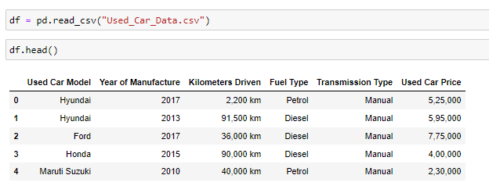
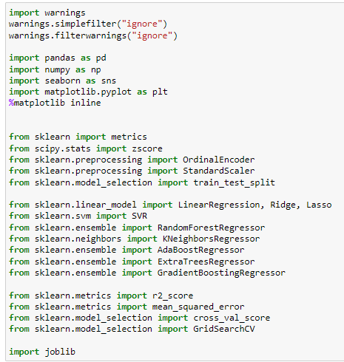
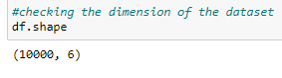
Working with the Dataset
Loading the dataset:
Importing Libraries:
There are 10000 rows and 6 columns present in our dataset.

Slide 13
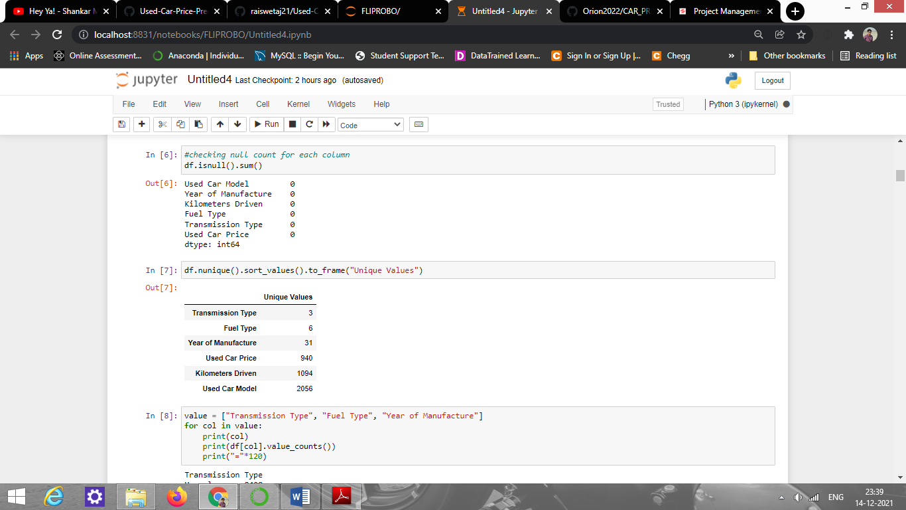
Missing Values In dataset
Observation:
There are no any missing values present in the dataset.

Slide 14
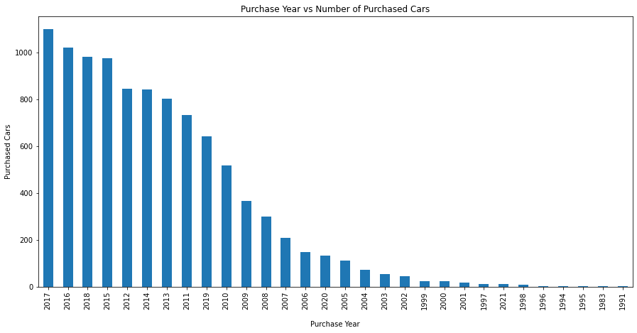
PURCHASE DETAILS OF USED CARS EACH YEAR
Observation:
The number of cars being purchased each year has increased a lot after 2008. Most of the people started preferring to get used cars and all the available online sources helped in expediting genuine process of getting good quality used cars with hassle free Registration Certificate (RC) transfers.

Slide 15
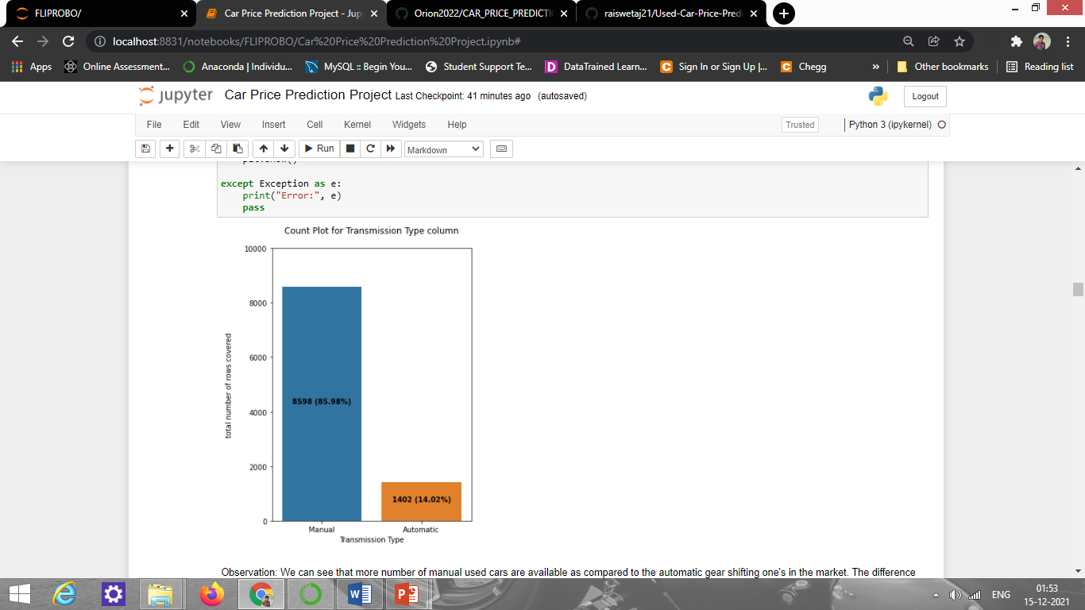
COUNT PLOTS
Observation:
We can see that more number of manual used cars are available as compared to the automatic gear shifting one's in the market. The difference is quite huge and readily available well conditioned used cars have manual gear shifting options.

Slide 16
BAR PLOTS
Observation:
Year of manufacture for both manual and automatic gear shifting cars are same

Slide 17
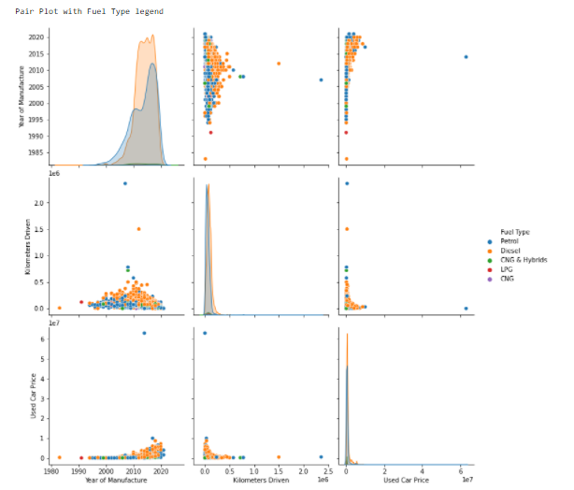
PAIR PLOTS

Slide 18
OUTLIERS WITH BOXEN PLOTS
Observation:
We can see that there are few outliers present in our dataset that needs to be treated.

Slide 19
SKEWNESS WITH DISTRIBUTION PLOTS
Observation:
We see that our target column is the one showing the highest skewness and it won't be much of a concern to us. However we see slight skewness in our feature columns that will need to be treated.

Slide 20
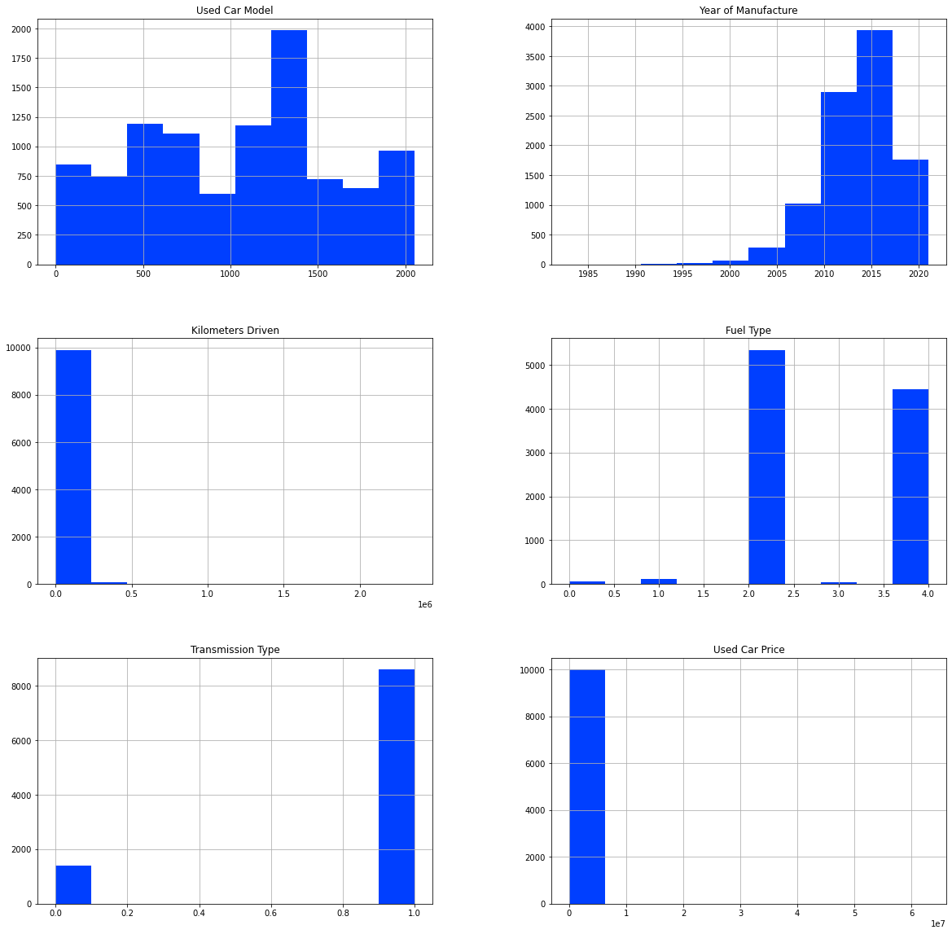
HISTOGRAM
Remarks: With the help of histogram we are able to see the data distribution for our dataset columns.

Slide 21
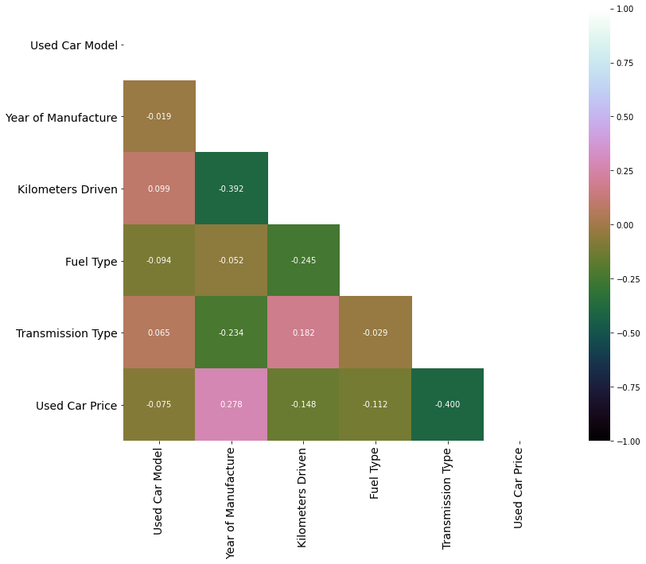
HEATMAP to check correlation
Observation:
In the correlation heatmap we can see that only "Year of Manufacture" is positively correlated with our label column while the other feature columns are negatively correlated. Also we see no multi-collinearity concerns between the feature variables and will not have to worry about the same.

Slide 22
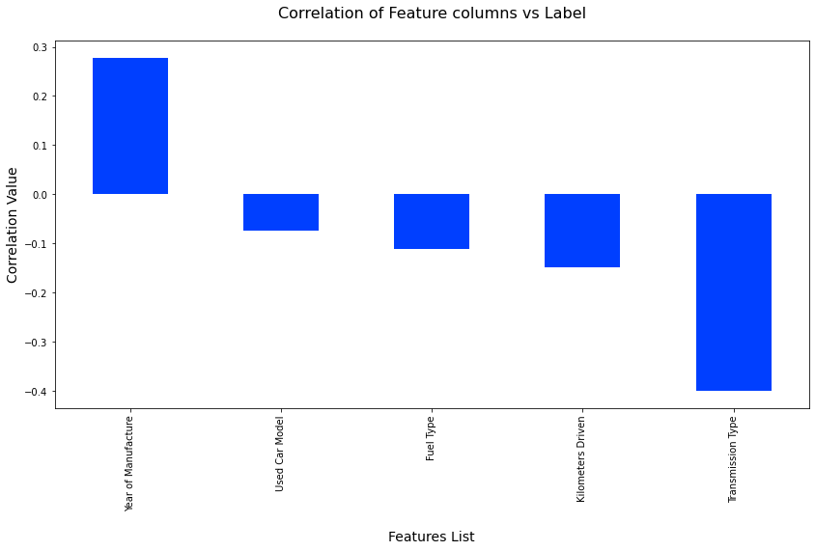
CORRELATION BAR GRAPH
Observation:
Here we have a visual on the positively and negatively correlated feature columns with our target variable.

Slide 23
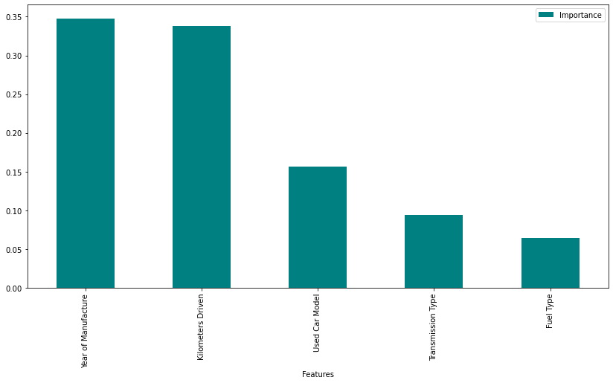
FEATURE IMPORTANCE BAR GRAPH
Remarks:
we can see the columns arranged in descending order as per their importance weightage while predicting our label variable.

Slide 24
REGRESSION MACHINE LEARNING MODEL/S USED
▪ Linear Regression Model
▪ Ridge Regularization Model
▪ Lasso Regularization Model
▪ Support Vector Regression Model
▪ Random Forest Regression Model
▪ K Neighbours Regression Model
▪ Gradient Boosting Regression Model
▪ Ada Boost Regression Model
▪ Extra Trees Regression Model

Slide 25
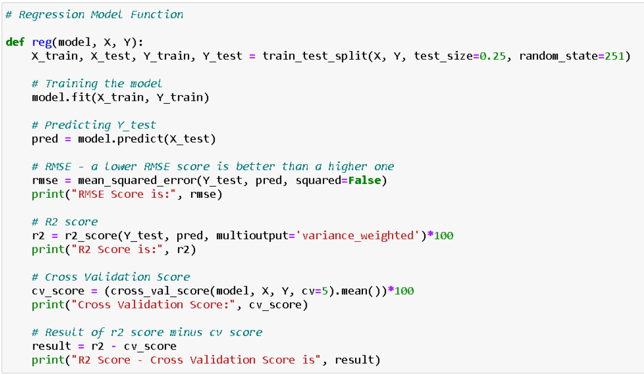
REGRESSION MODEL FUNCTION WITH EVALUATION METRICS

Slide 26
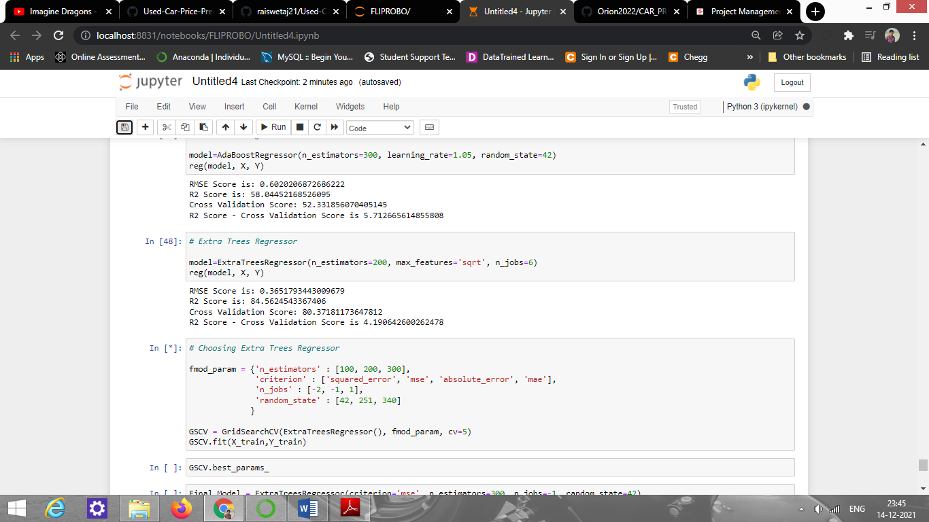
RESULT OF MULTIPLE REGRESSION MODELS
Remarks:
Choosing ExtraTreeRegressor as our best model because it is performing good.

Slide 27
EVALUATION AND HYPER PARAMETER TUNING
The key metrics used are:
R2 score
Cross Validation Score
MAE
MSE
RMSE
We tried to find out the best parameters list to increase our accuracy scores by using Hyperparameter Tuning. In order to achieve a higher score we used the Grid Search CV method with 5 folds.

Slide 28
CONCLUSION
After the completion of this project, we got an insight on how to collect data, pre-processing the data, analyzing the data and building a model. First, we collected the used cars data from different websites like OLX, Car Dekho, Cars 24, OLA etc. and it was done by using Web Scraping.
The framework used for web scraping was Beautiful Soup and Selenium, which has an advantage of automating our process of collecting data. We collected almost 10000 of data which contained the selling price and other related features of used cars. Then the scrapped data was combined in a single data frame and saved in a csv file so that we can open it and analyze the data.

Slide 29
CONCLUSION
We did data cleaning, data pre-processing steps like finding and handling null values, removing words from numbers, converting object to int type, data visualization, handling outliers and skewness etc. After separating our train and test data, we started running different machine learning regression algorithms to find out the best performing model.
We found that Extra Tree Regressor Algorithm was performing well according to their r2_score and cross validation scores. Then we performed Hyperparameter Tuning technique using Grid Search CV for getting the best parameters and improving the score. In that Extra Tree Regressor Algorithm did not perform quite well as previously on the defaults but we finalized that model for further predictions as it was still better than the rest. We saved the final model in pkl format using the joblib library after getting a dataframe of predicted and actual used car price details.

Slide 30
LIMITATIONS OF THIS WORK AND SCOPE FOR FUTURE WORK
The limitations we faced during this project were:
The website was poorly designed because the scrapping took a lot of time and there were many issues in accessing to next page. Also need further practice in terms of various web scraping techniques. More negative correlated data were present than the positive correlated one's. Presence of outliers and skewness were detected and while dealing with them we had to lose a bit of valuable data. No information for handling these fast-paced websites were provided so that was consuming more time in web scraping part.
Future Work Scope:
Current model is limited to used car data but this can further be improved for other sectors of automobiles by training the model accordingly. The overall score can also be improved further by training the model with more specific data.

Slide 31
References:
1) https://www.google.com/
2) https://github.com/
3) https://www.kaggle.com/
4) https://towardsdatascience.com/
5) https://www.analyticsvidhya.com/

Slide 32
THANK YOU

